Slide 1

Comparative Performance Evaluation of IPv4 and IPv6 Transmission Protocols
Author: Dhamme Amarasinghe
Presenter: Ibrahim burhani & Hanzala Bhatti
A thesis submitted in partial fulfillment of the requirements for the degree of Master of Applied Technologies in the School of Computing, Electrical & Applied Technology. 06/03/2025

Slide 2
Introduction: The Evolving Internet Landscape
The Internet, connecting billions of devices from laptops to IoT appliances, faces increasing demand. Internet Protocol (IP) is its cornerstone, with IPv4 as the long-standing driver and IPv6 as its successor, designed to overcome IPv4's limitations.
IPv4: Limitations
IPv6: The Solution
32-bit address space, exhausted by device growth. Relied on NAT to extend utility.
128-bit address space, virtually limitless. Improved efficiency, reduced fragmentation, mandatory IPSec support.
Transitioning to IPv6 presents challenges, including dual-stack complexity and the role of tunneling strategies like 6to4 and ISATAP.

Slide 3



Transition Protocols: Bridging the Gap
This chapter explores the foundational theories of IPv4 and IPv6, and the transition techniques 6to4, ISATAP, and Dual-Stack. These are instrumental in shaping data communication across networks today.
Dual-Stack
Devices operate with both IPv4 and IPv6 simultaneously, ensuring seamless functionality during transition.
6to4 Tunneling
Automates IPv6 tunnel creation over IPv4 networks, facilitating communication between IPv6 devices.
ISATAP Tunneling
Allows IPv6 packets over IPv4 infrastructure by treating the IPv4 network as a link layer.

Slide 4
IPv4 vs IPv6 Performance In Real-World
This 90-credit thesis compares IPv4 and IPv6 performance, evaluating transition mechanisms like 6to4, ISATAP, and Dual-Stack. Using specially configured testbeds with Cisco 2900 series routers and CAT8 cables, we measure throughput, delay, and jitter across various packet sizes.
Key Findings: Throughput
Key Findings: Delay
Key Findings: Jitter
Max delay: 39.55 ms (IPv6). Min delay: 4.82 ms (Dual-Stack).
Highest jitter: 0.000406 ms (6to4). Lowest jitter: 0.000226 ms (ISATAP, IPv4).
Max throughput: 948 Mbits/sec (IPv4, Dual-Stack). Min throughput: 914 Mbits/sec (6to4).
The findings emphasize a strategic approach to IPv6 adoption, leveraging transition protocols for uninterrupted service and scalability.

Slide 5
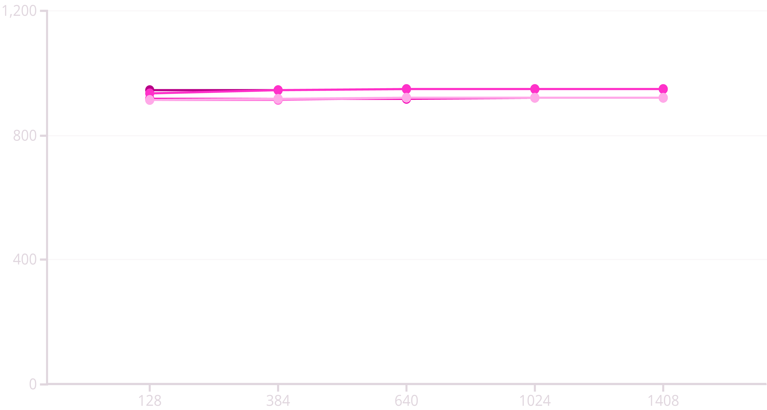

Experimental Results: Throughput Analysis
This section analyzes throughput data from our testbeds, evaluating IPv4, IPv6, Dual-Stack, 6to4, and ISATAP across various packet sizes (128 to 1408 bytes). TCP protocol was used for all tests.
IPv4 (Mbit/sec)
IPv6 (Mbit/sec)
Dual-Stack (Mbit/sec)
6to4 (Mbit/sec)
ISATAP (Mbit/sec)
IPv4 Dominance
Dual-Stack Efficiency
Tunneling Overhead
Consistently highest throughput, peaking at 948 Mbits/sec due to smaller header size.
Matches IPv4's peak at 948 Mbits/sec for larger packets, balancing both protocols.
6to4 and ISATAP show lower throughput due to encapsulation overhead.

Slide 6
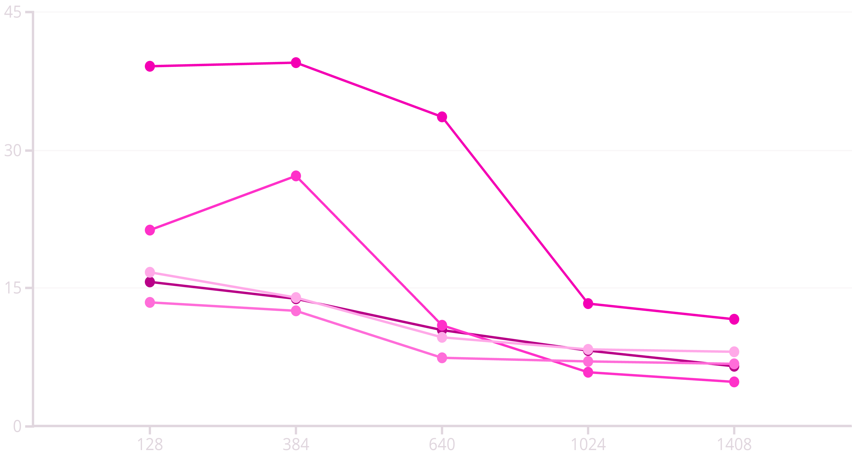
Experimental Results: Delay Analysis
This section presents the network delay analysis for IPv4, IPv6, Dual-Stack, 6to4, and ISATAP across varying packet sizes (128 to 1408 bytes).
IPv4 (ms)
IPv6 (ms)
Dual-Stack (ms)
6to4 (ms)
ISATAP (ms)
IPv4: Lowest Delay
IPv6: Highest Delay
Dual-Stack: Moderate
Consistently lowest delays (6.5 ms at 1408 bytes) due to lower processing overhead.
Highest initial delays (39.55 ms at 384 bytes), but improves with larger packets.
Balances IPv4 and IPv6, with lowest delay at 4.82 ms for 1408 bytes.

Slide 7
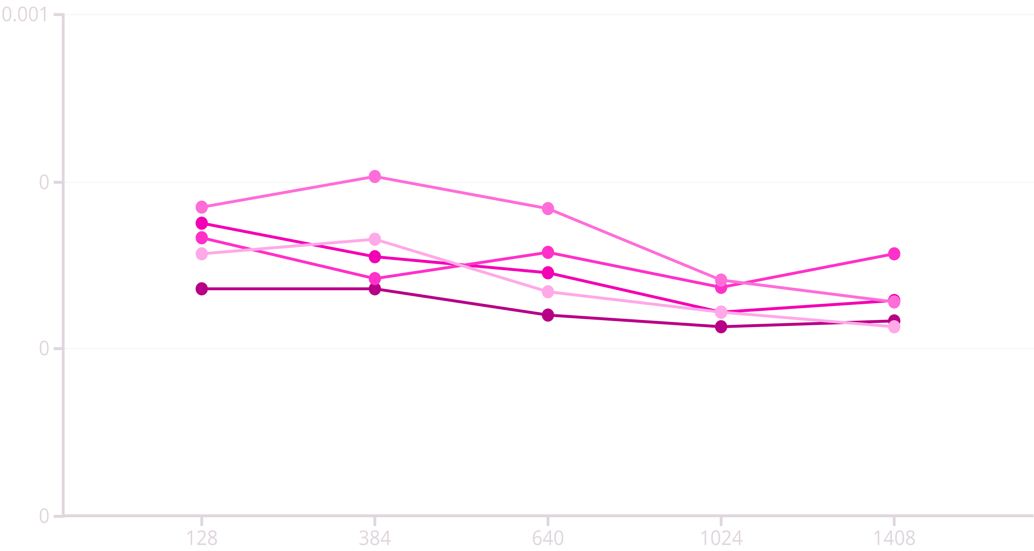
Experimental Results: Jitter Analysis
This section examines jitter across IPv4, IPv6, Dual-Stack, 6to4, and ISATAP, revealing how each protocol manages packet timing variability.
IPv4 (ms)
IPv6 (ms)
Dual-Stack (ms)
6to4 (ms)
ISATAP (ms)
IPv4 & ISATAP: Best Jitter
6to4: Highest Jitter
Dual-Stack: Moderate
Both achieve lowest jitter at 0.000226 ms, ideal for stable packet delivery.
Peaks at 0.000406 ms, indicating significant variability in packet timing.
Moderate jitter, less optimal for latency-sensitive applications.

Slide 8

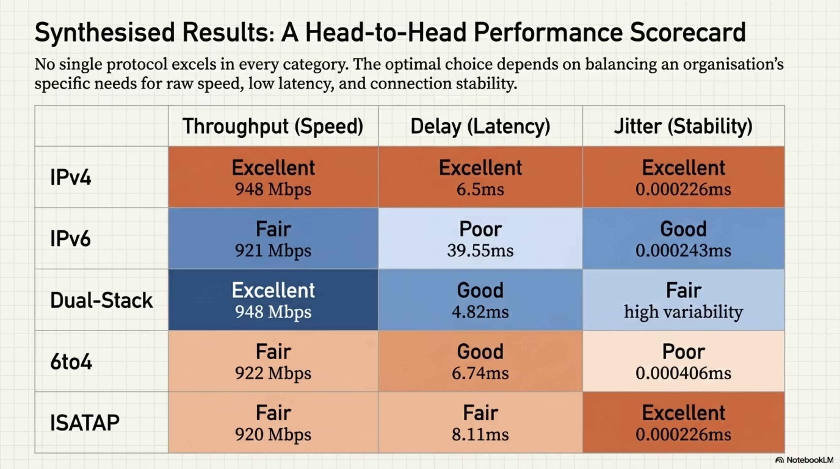

Slide 9
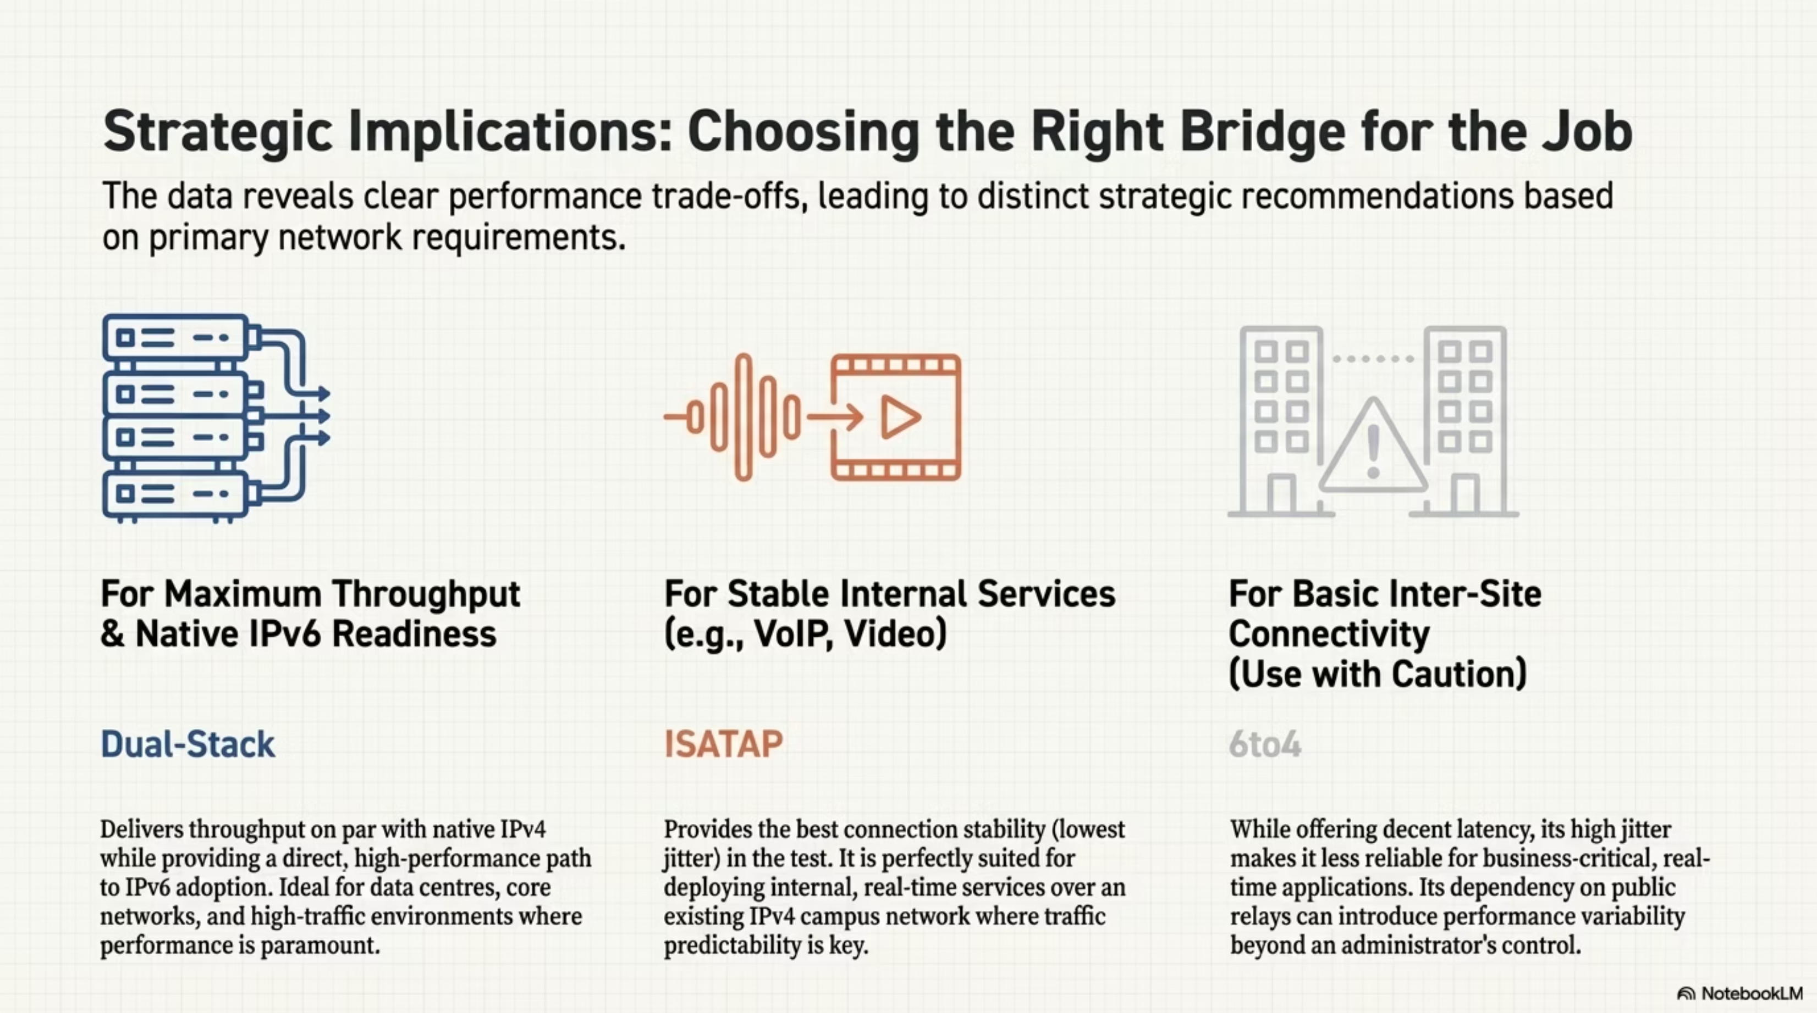

Slide 10
Conclusion
Our research provides comprehensive insights into IPv4, IPv6, and transition protocols' performance. Dual-Stack excels in throughput, while IPv4 and ISATAP lead in low jitter.
948
4.82
0.000226
Mbits/sec
ms
ms
Max throughput (Dual-Stack, IPv4).
Min delay (Dual-Stack).
Min jitter (ISATAP, IPv4).
IPv4 consistently outperformed IPv6 across all metrics. Dual-Stack emerged as the best transition protocol for throughput, while ISATAP was best for jitter. These findings are crucial for network engineers optimizing systems and navigating the IPv6 transition.

